Slide 1
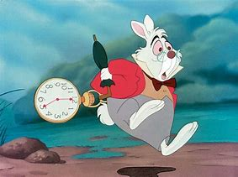
What word would describe you best?

Slide 2

What were the first impressions you got from walking into in our organization?
- A new beginning.

Slide 3

Name at least 1 of your strengths (Strong points)? And 1 of your flaws (Weak points)?
- Strong point Courage, weak point Time
What are your favorite websites, apps or other resources? Why?
- Instagram, for the network of distant friends , having lived all over France, I have contacts everywhere

Slide 4

What is your worst memory from work?
- Electrical work accident
If you could change something from the past, what would it be?
- Standing up to my mother and doing my studies today 20 years ago

Slide 5

If you could compare yourself with any animal, which would it be and why?
- A Cat, I always fall back on my paws.
What piece of advice would you give your previous boss?
- Learn the business before imposing unachievable deadlines

Slide 6
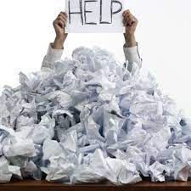

What makes you uncomfortable?
Being in a situation where I have no skills and therefore no control
What is your experience in IT?
- website more than 20 years ago
and automation

Slide 7
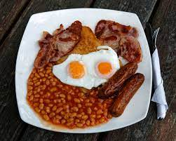
If I say “English”, what do you say?
- English breakfast

